Slide 1
University of Asia Pacific
Department Of Computer Science and Engineering
Life Saving
Presentes By
Meher Niger - 19201043
Rifa Tasfia - 19201045
Ashikur Rahman Sumon – 19201055
Hasan Al Mamun - 19201059

Slide 2
Content
About This Project
Motivation
Conclusion
Advantages
Disadvantages

Slide 3
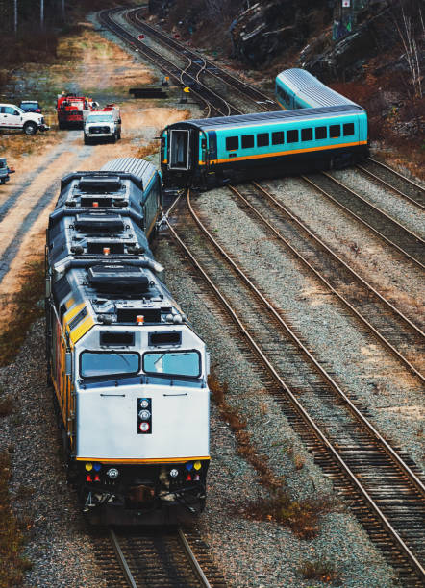
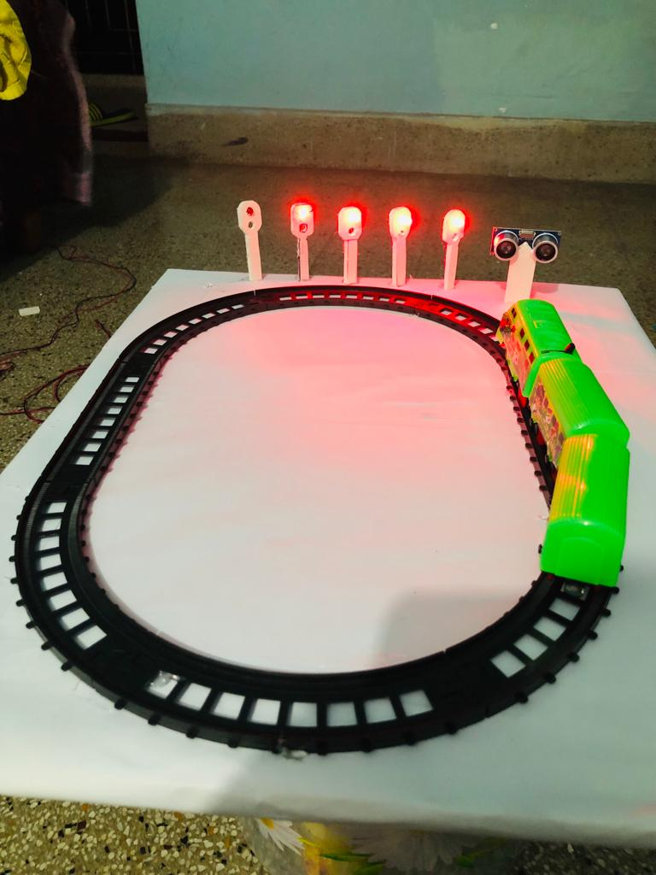
About this project
In Bangladesh many people walk or take rest in the railway line. Sometimes for their lack of attention many accidents occur.
So this project's main purpose is to prevent these accidents and also in the rail gate.
Gate man can use this technology to close road blockers.

Slide 4

Motivation
According to WIKIPEDIA every year 100 people die and 10 accounts occur in the rail line.
This type of incident occurred just for miscommunications.
So using this technology we can prevent this type of accident
https://en.wikipedia.org/wiki/Lists_of_rail_accidents

Slide 5
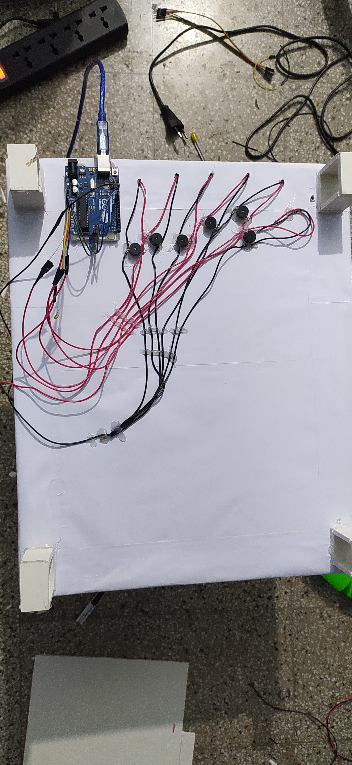
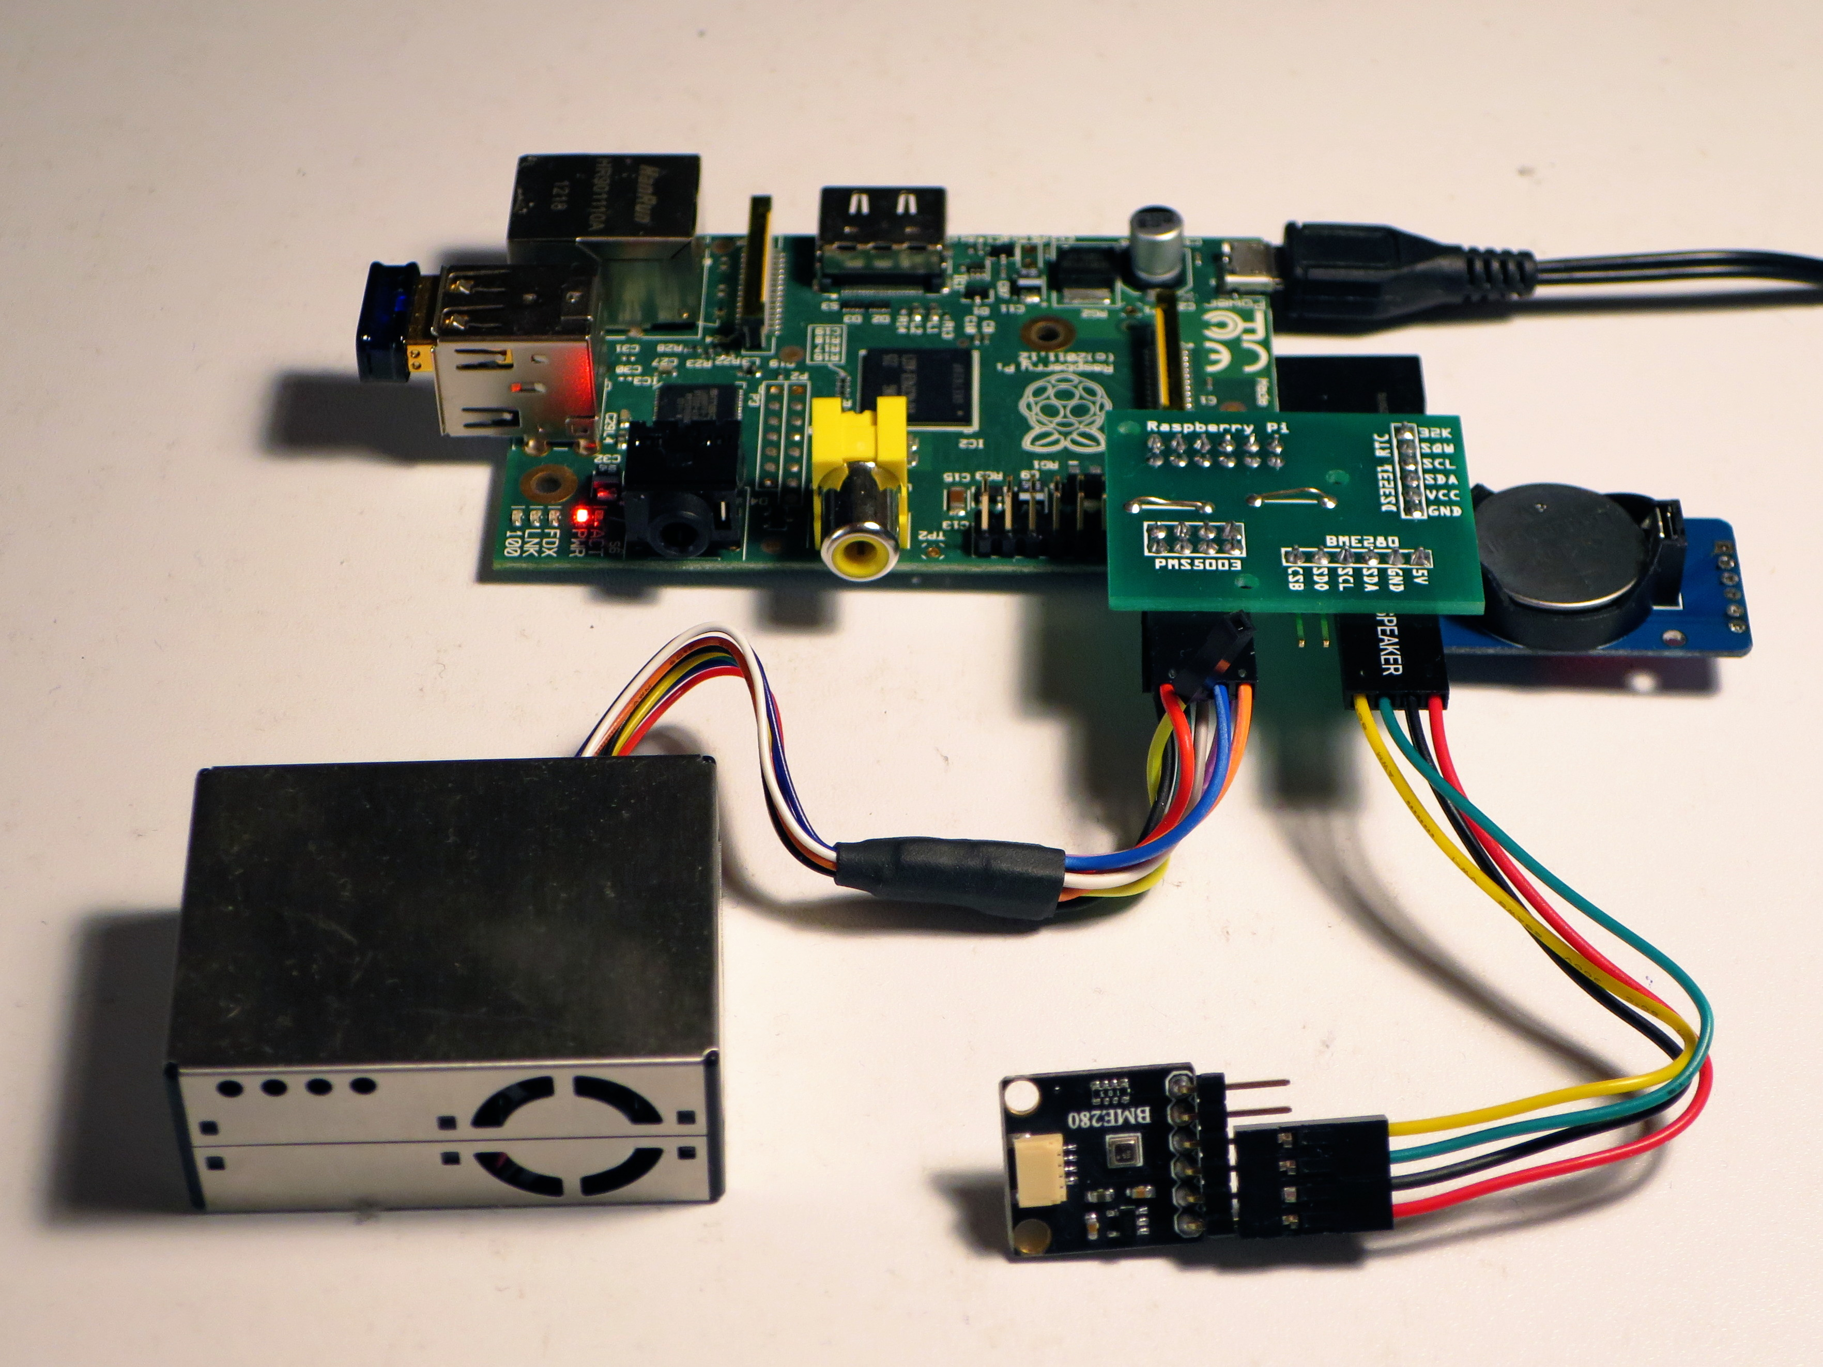
1.Arduino Uno. 2.Ultrasonic sensor. 3.Sunboard Sheet. 4.Jumper wires. 5.5x Led lights. 6.5x Buzzer.
Hardware Required

Slide 6
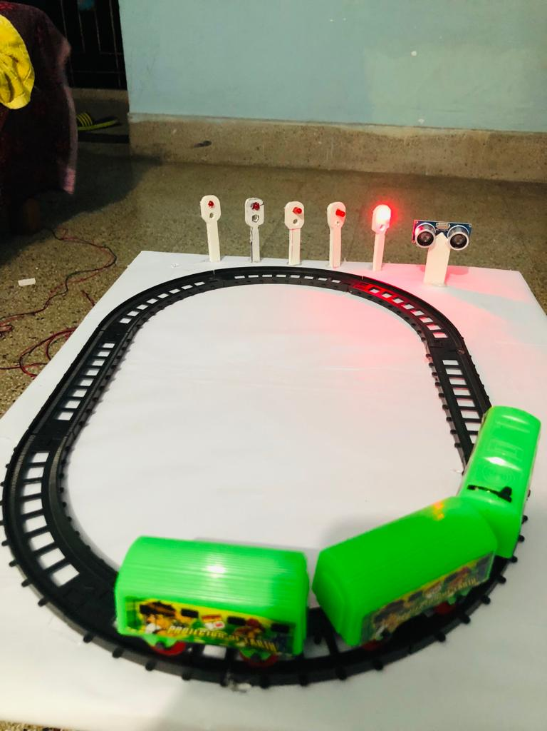
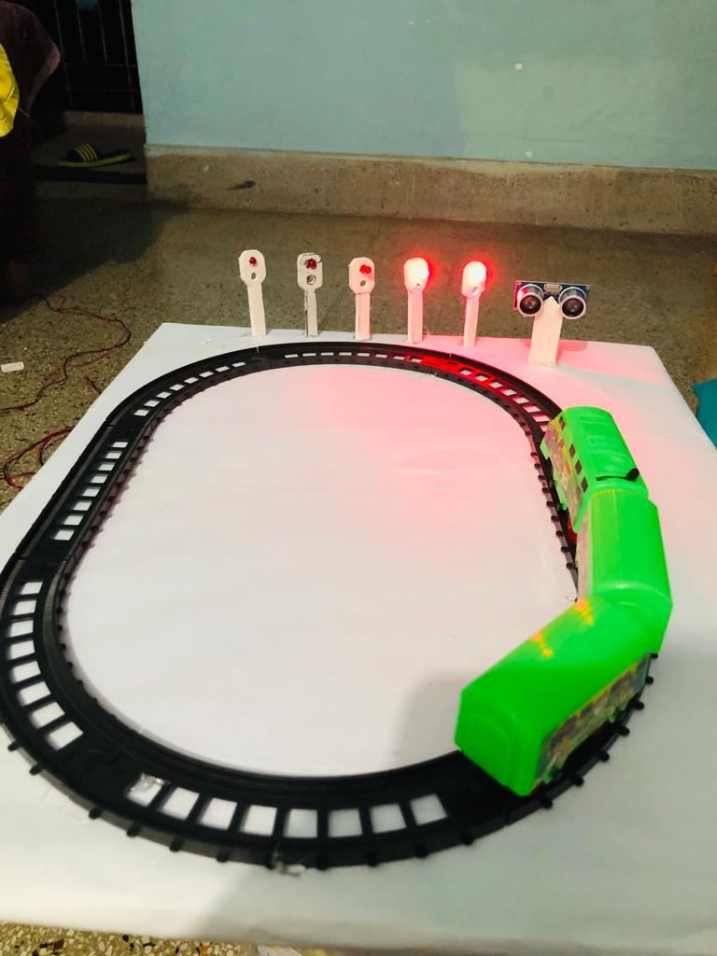
How the project view
Front view

Slide 7
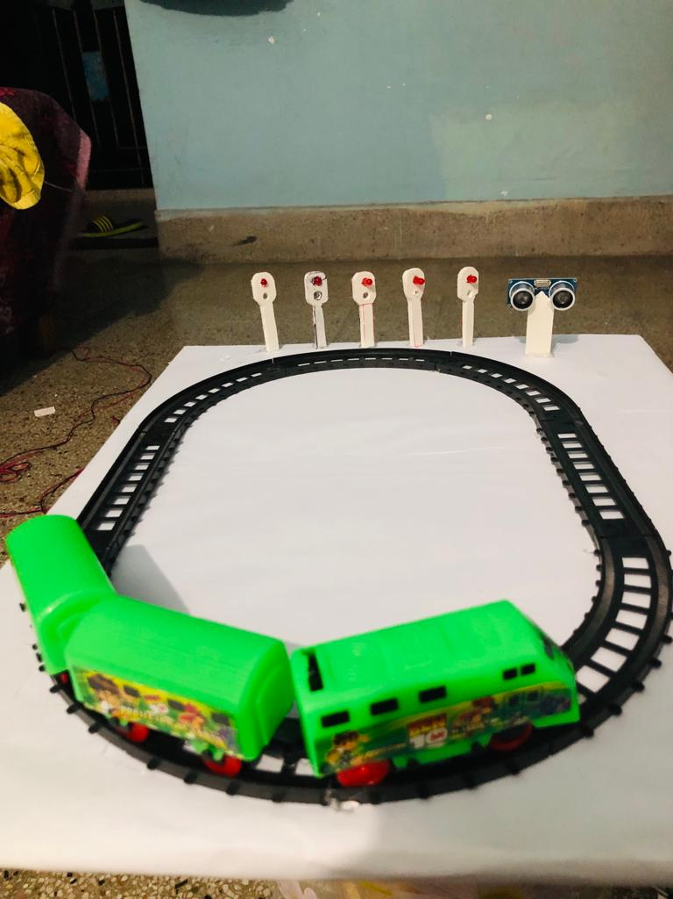
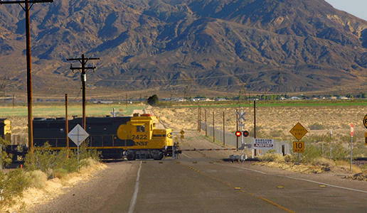
Side view
3D view

Slide 8
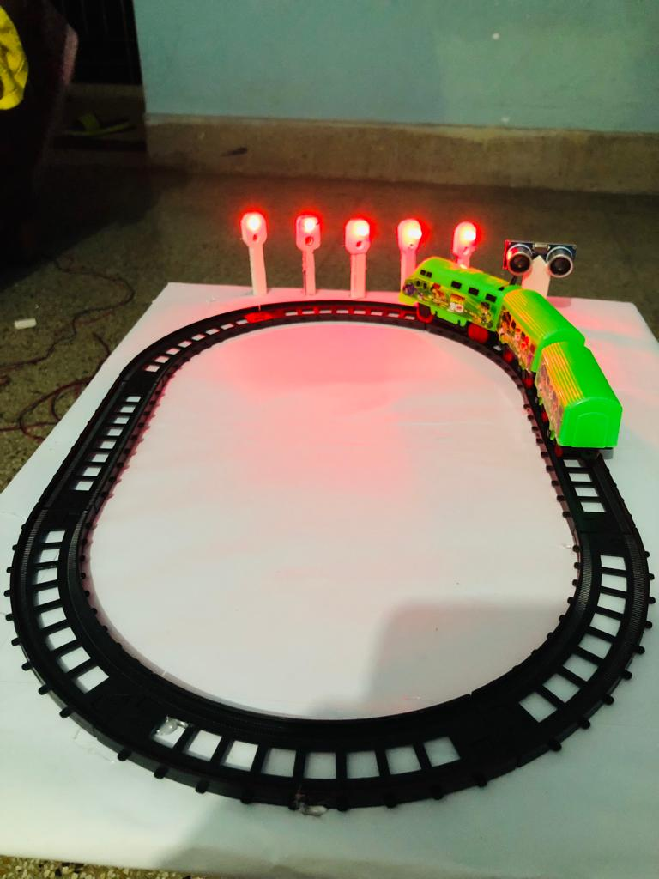
How does it works
Object detection by Ultrasonic sensor.
LED Blinking.
Generate an alarm .

Slide 9
Advantage
Acts automatically to prevent collisions.
System can withstand even in harsh environments.
Economical & cost effective.
Elimination of human error as no inputs are to be fed by the crew.
Can prevent accidents and also our rail journey will be more safe.

Slide 10
Disadvantage
Adequate braking distance at the speed is not available when a dangerous collision-like situation arises suddenly.
Failure to brake power of the locomotives.
For this technology we always need ardiuno. If ardiuno fails everything will be lost and can cause huge damage. For this situation we also have to manage a manual system.

Slide 11

Our world is moving so fast and we can prevent many accidents using technology. Day by day we need to adopt new technology to make our life easier.
Conclusion

Slide 12
Thank You

